Slide 1

Final Year Project (Mid term) Session:2021-2022

Slide 2
Gesture Recognition for Specially Abled People
Supervisor (s): Mr. Sumit Kumar
Team Member(s): Parakh Singhal, Shweta Saini
Name (Roll No.): 18csu152, 18csu245
DEPARTMENT NAME

Slide 3
Description Of The Topic
Sign Languages are a medium of communication for specially-abled people who are having difficulties while speaking and listening.
They provide a gesture for them to communicate and get along with the life with others.
It is a visual form of language that uses expression and movements to convey the emotions and meanings.

Slide 4
Feasibility Study
Specially-abled peoples who have problems with speaking and hearing tend to use this sign language the most.
Because of this Online-system due to pandemic of COVID-19 their words being going unheard or missed.
Our platform identifies that issue and tend to come up with a solution which may benefit the whole communication process by allowing them to express more efficiently.

Slide 5
Existing Solutions/Literature Review
GnoSys
Netherlands-based start-up has developed an artificial intelligence (AI) powered smartphone app for deaf and mute people, which it says offers a low-cost and superior approach to translating sign language into text and speech in real time.
SignAll Launches Ace ASL App
AI-empowered solution enables users to practice American Sign Language (ASL). The system uses a camera to recognize signing and provide feedback. Ace ASL app is based on the same sign recognition technology that makes possible automated and spontaneous translation between American Sign Language and English. The mobile application is the first ASL learning app to provide real-time feedback on signing.

Slide 6
GAPS in existing solution/literature review
All the recognition or detection apps have launched their separate application which includes a prepaid cost for the use in real world.
Our approach is based on integrating our project with leading meeting platforms which will allow everyone to come together at the same medium.
Because if the specially abled person is having an Online meeting then it will not be easy for them to convey their message.
By integration of our project with these platforms we can ensure good customer attention and will benefit all.

Slide 7
Problem Statement
To identify what the person is trying to convey via sign language over an online or virtual meeting on platforms like Google Meet, Microsoft Teams, Zoom.
https://en.wikipedia.org/wiki/Chart

Slide 8
Objectives
To help the specially-abled people get to express their view in the Online-system by leveraging deep learning and image processing techniques.
The project will display the meanings of the sign made by the person on the screen.

Slide 9
Tools/platform Used
Technologies
Python
OpenCV
Flask
HTML, CSS
Deep Learning
LSTM

Slide 10
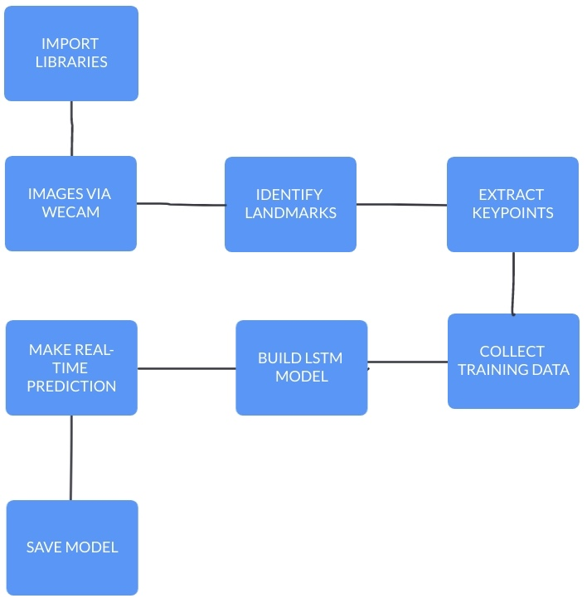
Flowchart

Slide 11
Design Methodology
Firstly we started with gathering the data on how to continue with this project and what will ne the requirements.
Then we researched about the libraries that can help us with the sign recognition.
Afterwards we tried to integrate the libraries with camera input.
Later a prototype was ready that showed how the final project will look.
Finally to increase the accuracy we used LSTM model.

Slide 12
Challenges and Issues identified
Challenges Identified | Solution
Compatibility, Communication, Long Distance | To overcome this we used application like AnyDesk to connect our computers and work on each others systems.
New Languages like Flask, HTML, CSS | Learned about each of them and got reference from websites like stackoverflow
Mediapipe integration with Flask and HTML | No reference was available for this part. We worked on this on our own.

Slide 13
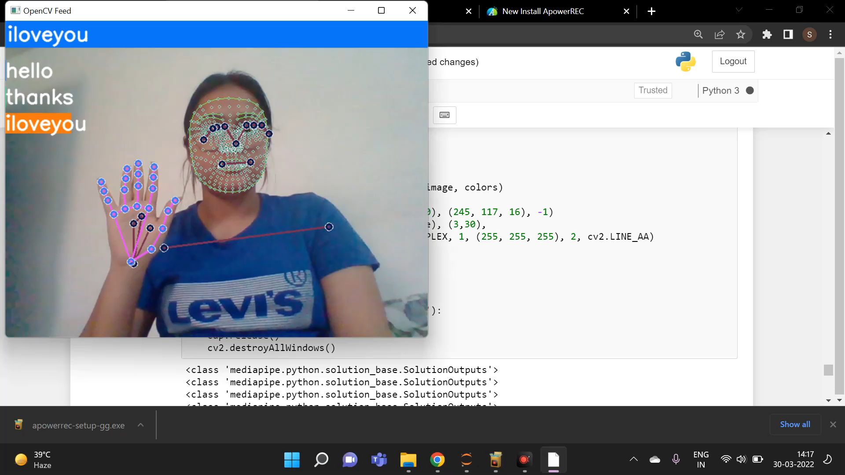
Demo Video
Before integrating with Flask:

Slide 14

Demo Video
After Flask integration

Slide 15
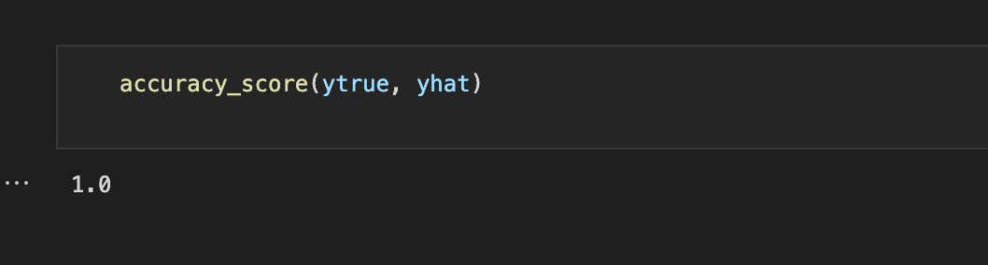
Testing and Performance Evaluation
As we use mediapipe library, developed by Google, at the backend, the accuracy is 95.7%
Link for above - https://google.github.io/mediapipe/solutions/hands.html#:~:text=With%20the%20above%20techniques%2C%20we,of%2095.7%25%20in%20palm%20detection.
Also our LSTM model gives an accuracy of 100%

Slide 16
GANTT Chart

Slide 17
Responsibility Chart
Responsibility | Parakh Singhal | Shweta Saini
Research | 3 | 3
Analysis | 3 | 3
Data Collection | 2 | 2
Model Creation and other works | 3 | 3
Gathering knowledge for GUI | 2 | 2
Web Study | 2 | 2
Web Integration | 1 (Flask) | 1 (HTML, CSS)
Report and PPT | 3 | 3
1. Responsible; 2. Assist Role; 3. Cumulative

Slide 18



Broader Impact factor Status/ Business Plan
This work can help a lot of people with speaking and hearing difficulties.
Who rely onto third party applications while in the meetings.
Our work can be integrated with the leading meeting platforms like Google Meet, Microsoft Teams, Zoom, etc, which in return will help the people to interact more significantly and won’t affect their pockets much.
This integration will help us to gather good audience and further we can launch iur own application which will have many more features than provided with meeting platforms.

Slide 19
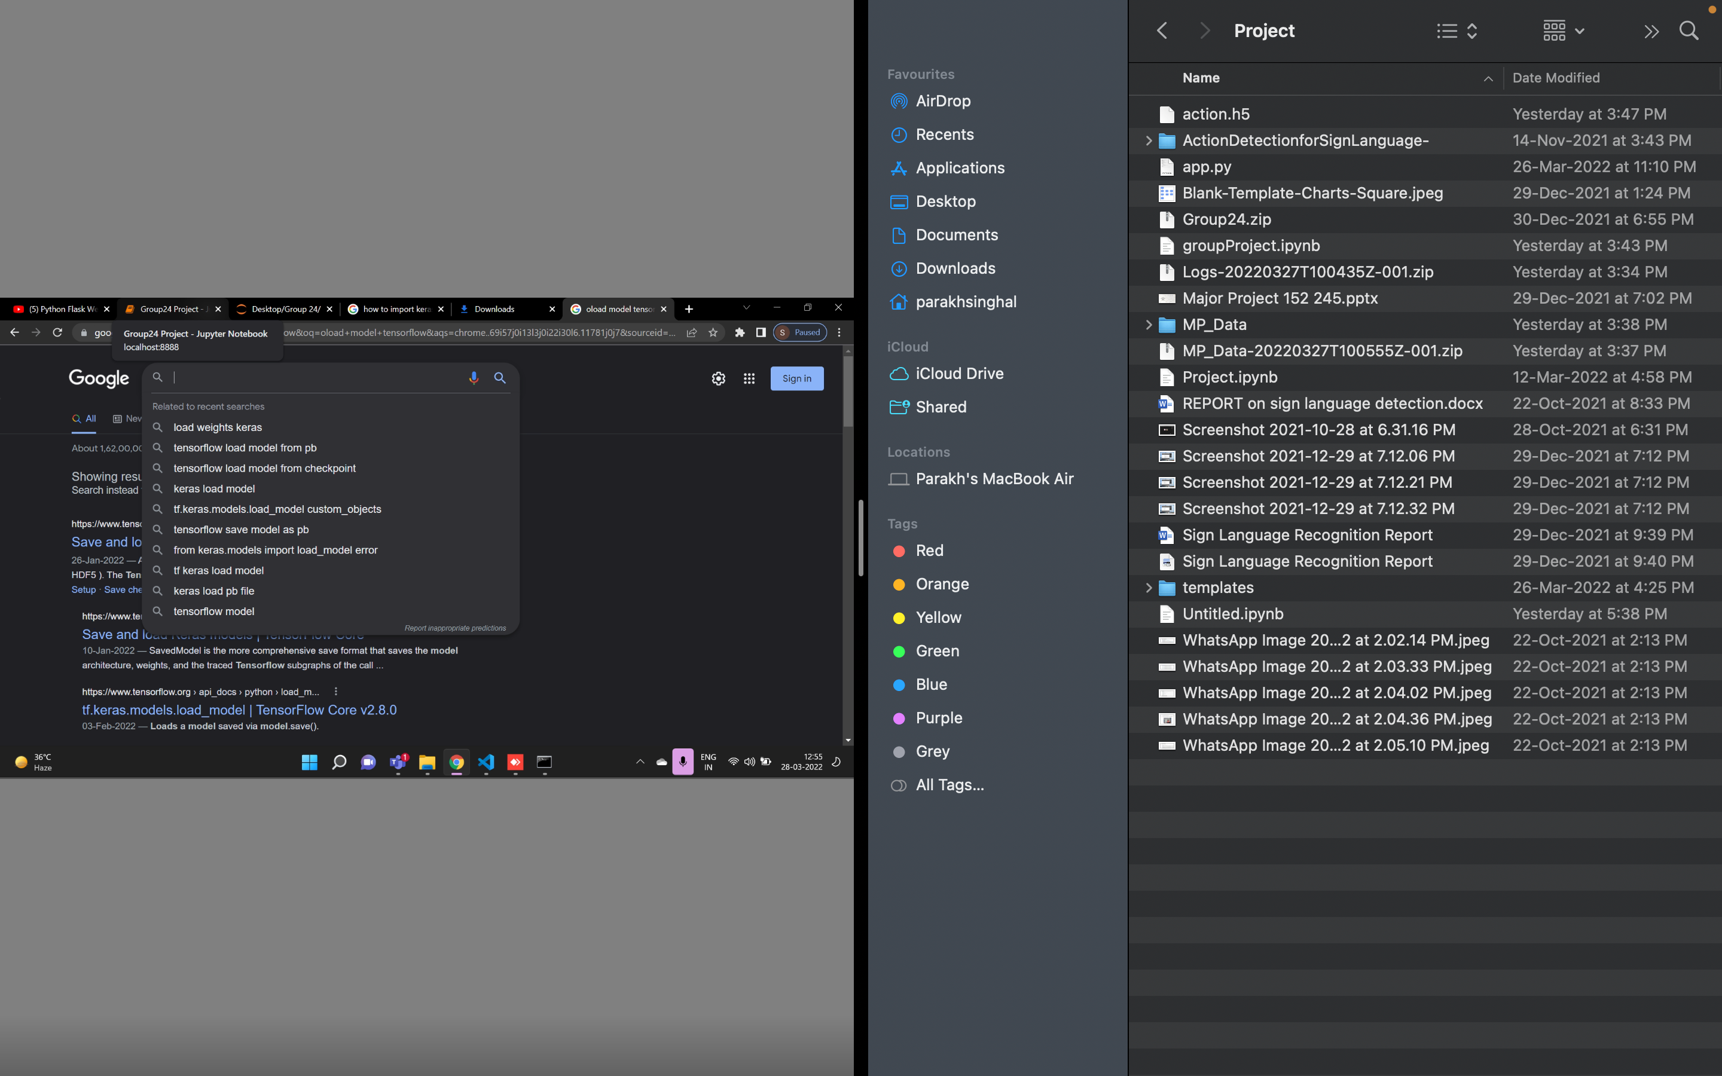
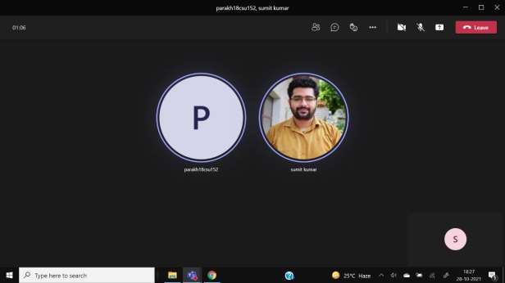
Screenshot of MS-Meetings(online)/comments(offline) by Guide

Slide 20
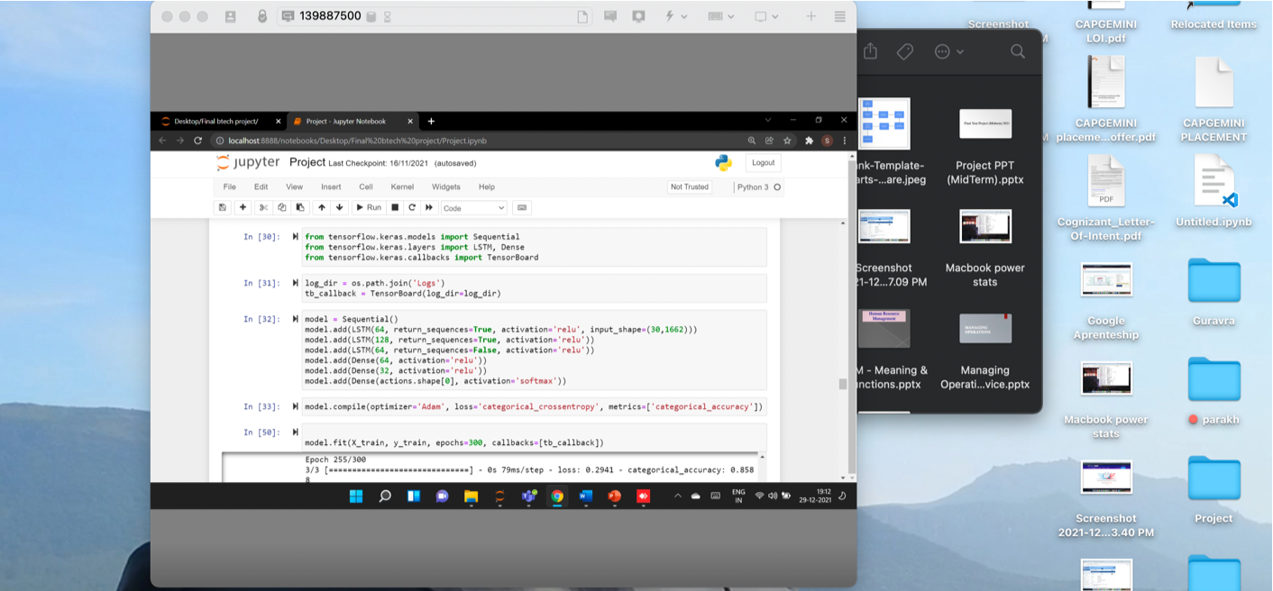
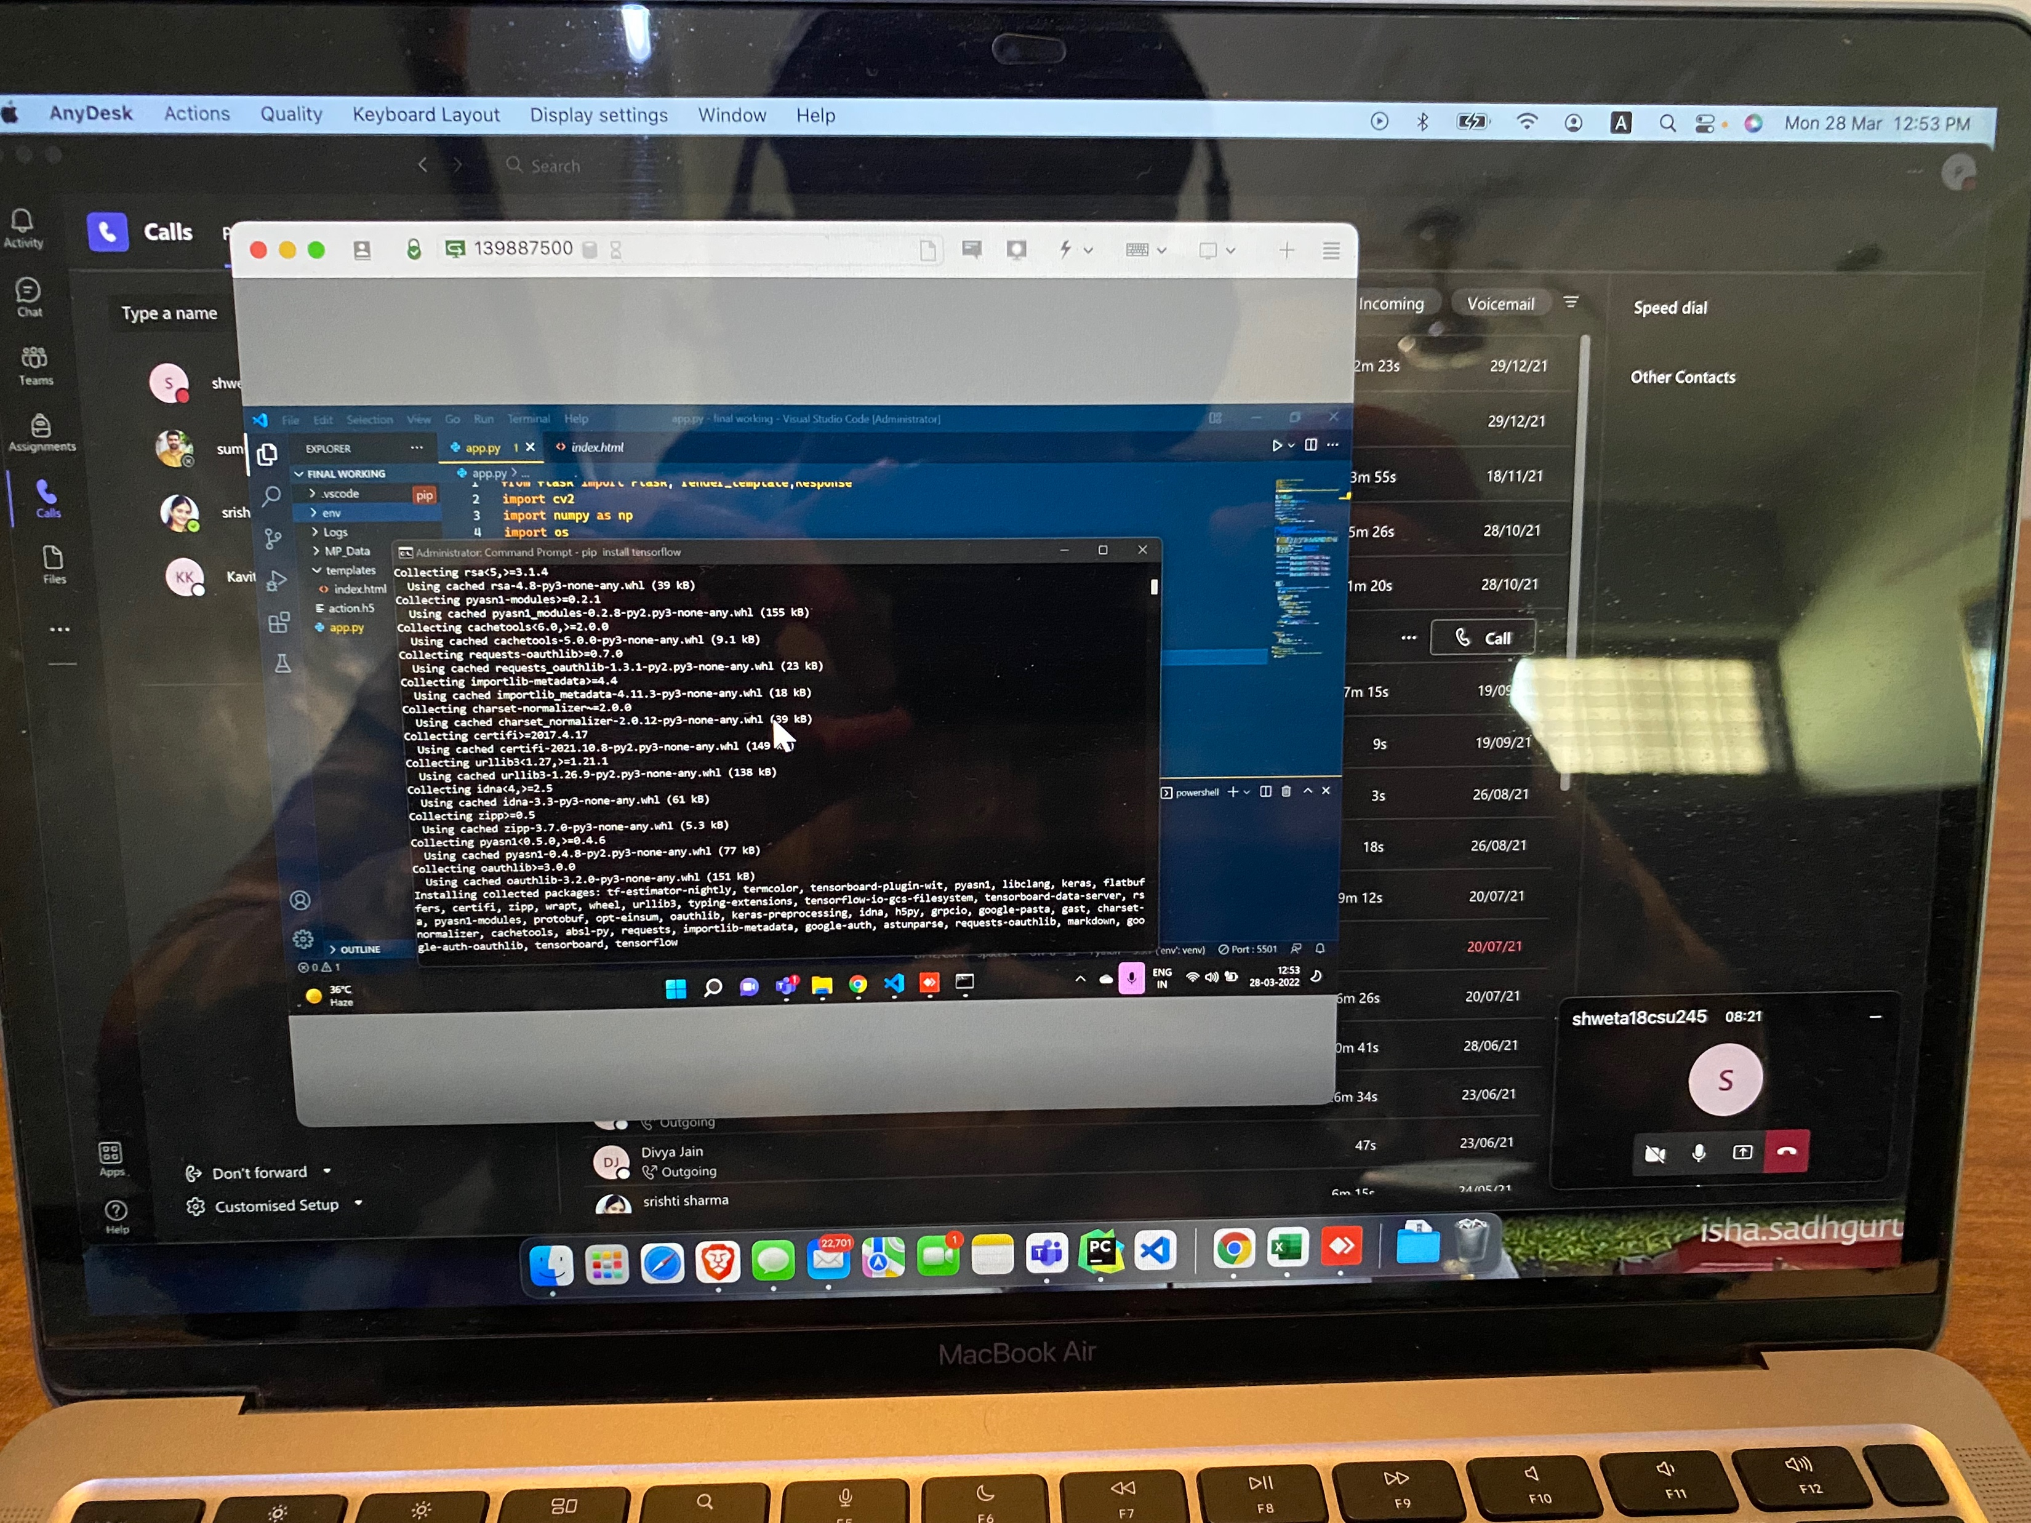
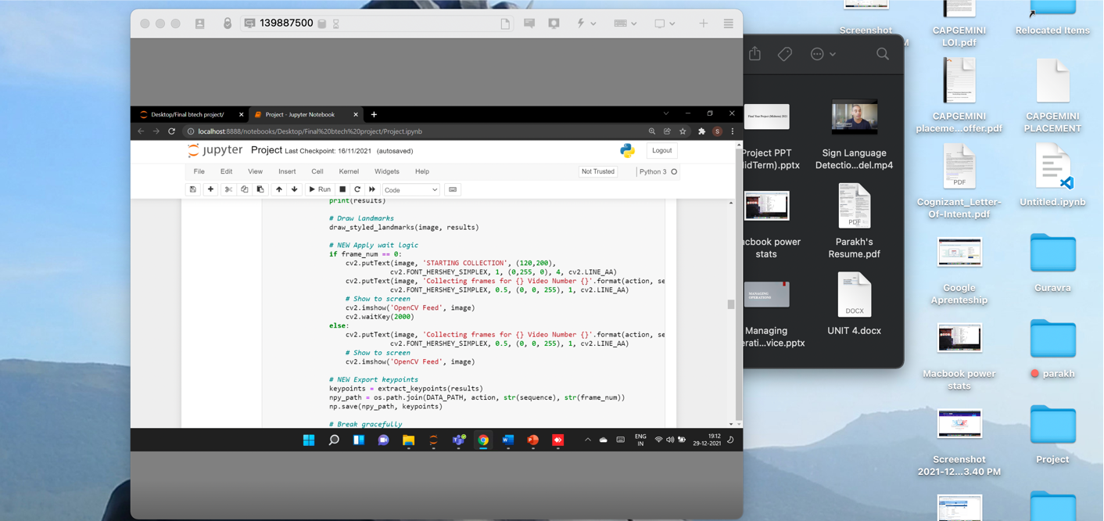
Screenshot of MS-Meetings(online)/comments(offline) by Guide

